Slide 1
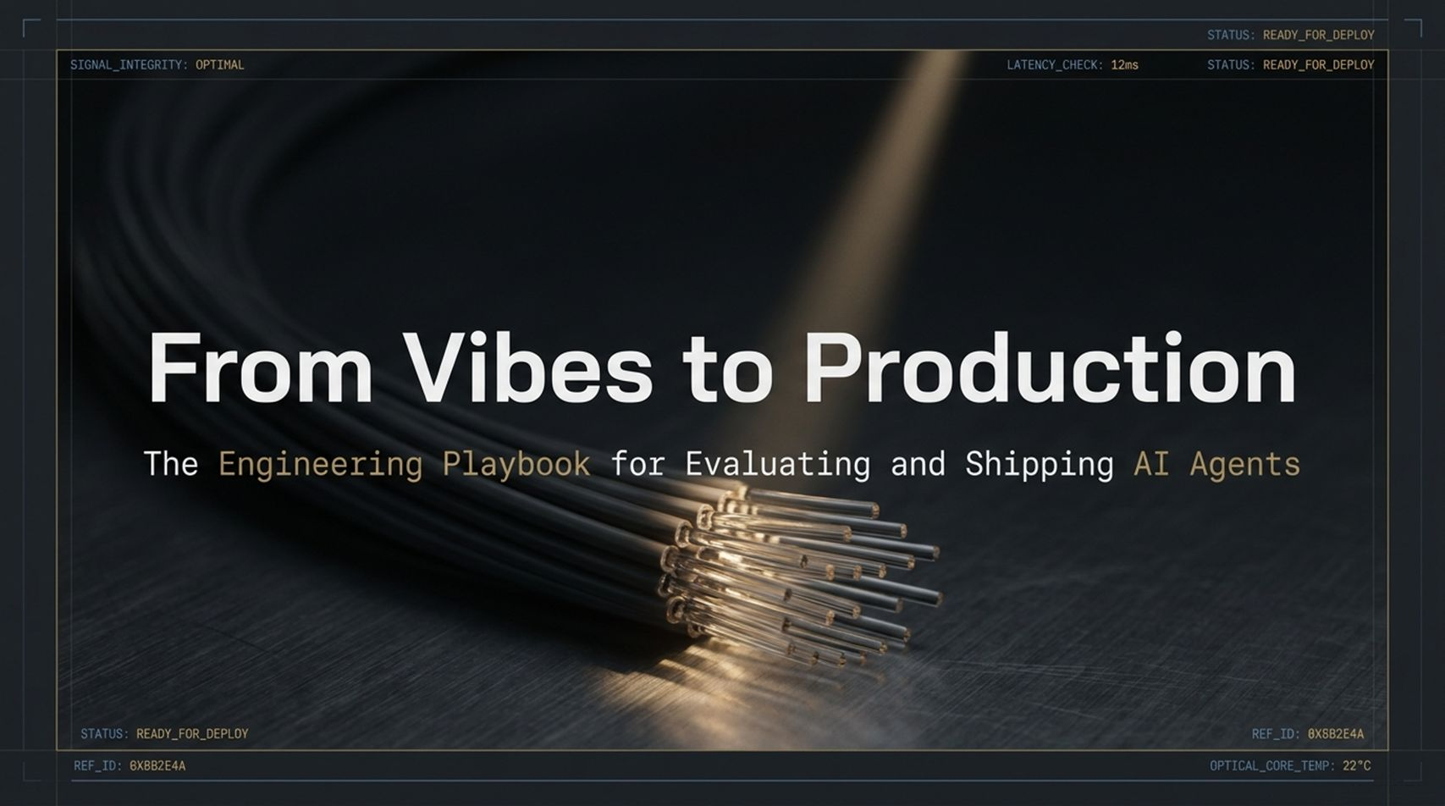
Notes:
Good morning, everyone, and welcome. Today, we are opening up the engineering playbook for what is arguably the single hardest problem in software development today: Evaluating and Shipping AI Agents into Production.
The title of this talk is From Vibes to Production: The Engineering Playbook for Evaluating and Shipping AI Agents. Over the past two years, almost every engineering team has built or prototyped an LLM-powered feature or autonomous agent. But there is a massive, painful gulf between getting an agent to work on your laptop during a demo and shipping a reliable, deterministic-feeling agentic system to millions of users in production.
Most teams start out evaluating their agents using what we call 'Vibes-based testing.' You write a prompt, you run three test queries, you skim the output, say 'Looks good to me,' and hit deploy. Then, two weeks later, an underlying model updates, or a user enters a slightly weird edge-case query, and the entire system falls apart silently.
Over the next 16 slides, we are going to replace 'vibes' with rigorous software engineering principles. We are going to cover telemetry tracing, multi-layered evaluation architectures, custom LLM rubrics, meta-evaluations, CI/CD regression guardrails, and automated self-healing feedback loops. By the end of this session, you will have a clear blueprint to build an evaluation flywheel that makes your AI systems continuously safer, faster, and more reliable over time.
From Vibes to Production: Evaluating and Shipping AI Agents That Work 101 — Laurie Voss, Arize AI
https://www.youtube.com/watch?v=qZj7sqmidqA

Slide 2
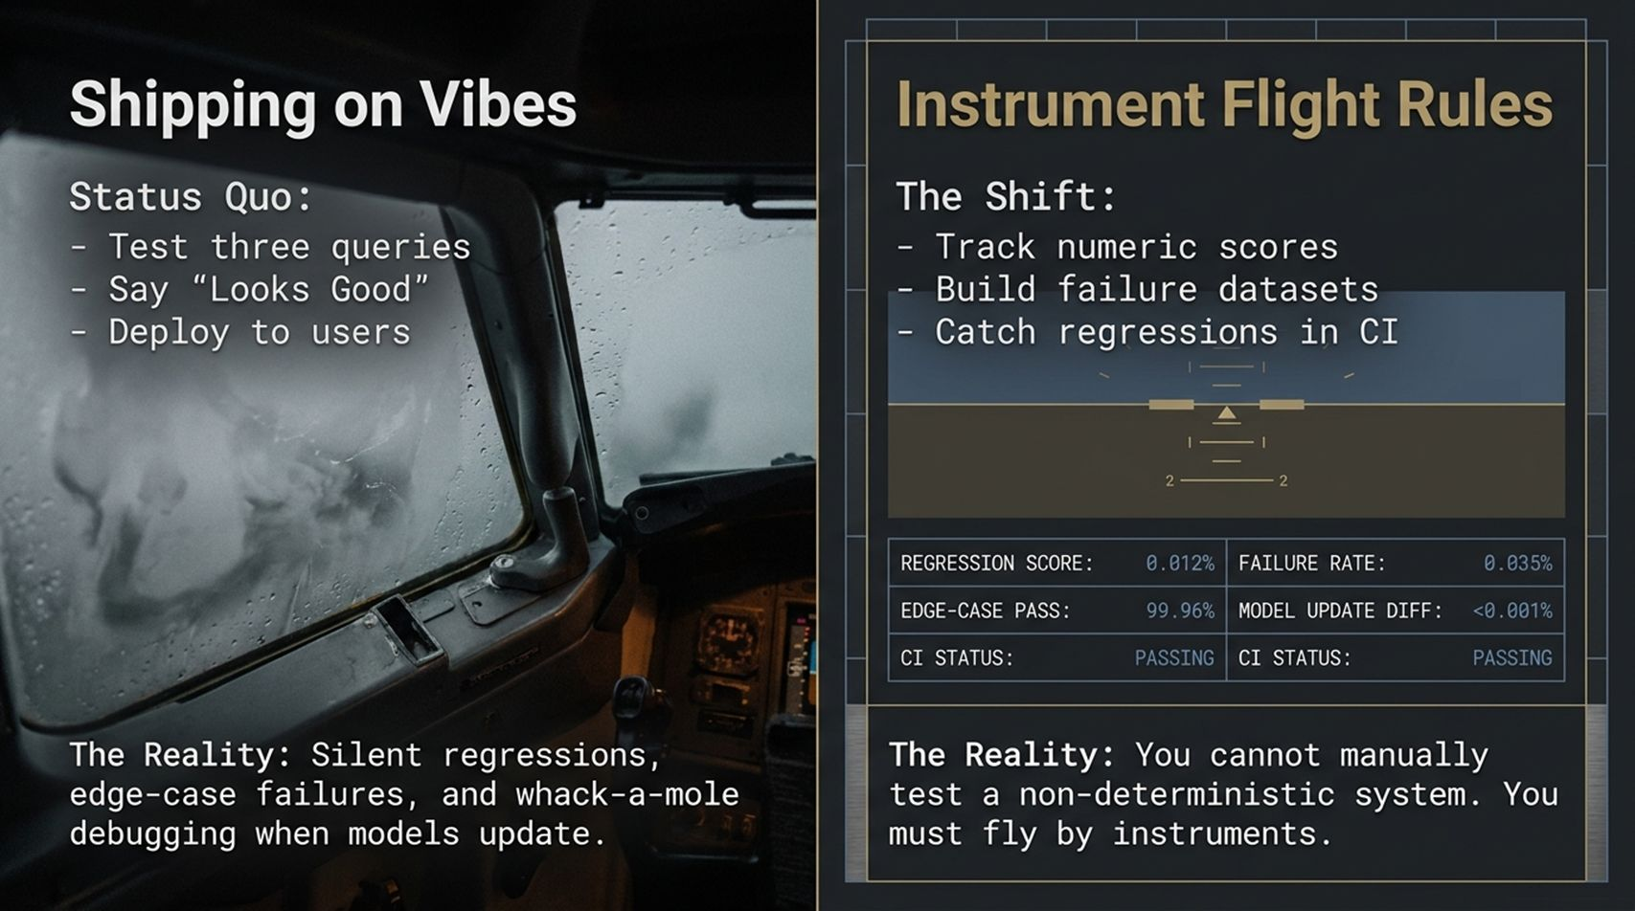
Notes:
Let's contrast the status quo of AI development with where production engineering needs to be.
On the left side of the slide, you see Shipping on Vibes. The current workflow for many teams looks like this: test three queries, feel good about the response, and ship to end-users. But what is the reality of this approach?
Non-deterministic systems don't fail with clean stack traces. They fail silently. You get silent regressions, catastrophic edge-case failures, and an endless game of 'whack-a-mole' prompt engineering. Every time you tweak a system prompt to fix one edge case, you secretly break three other working use cases without knowing it.
Now look at the right side: Instrument Flight Rules. Think of a commercial airline pilot flying through thick clouds. They cannot look out the window and rely on visual 'vibes.' They must rely entirely on flight instruments.
In software engineering, this shift means tracking concrete numeric scores, building dedicated failure datasets, and catching regressions in your CI pipeline before code ever reaches production. Look at the telemetry box on the slide: tracking regression scores down to 0.012%, monitoring edge-case pass rates at 99.96%, and auditing model update diffs automatically.
The core reality is simple: You cannot manually test a non-deterministic system. You must fly by instruments.

Slide 3
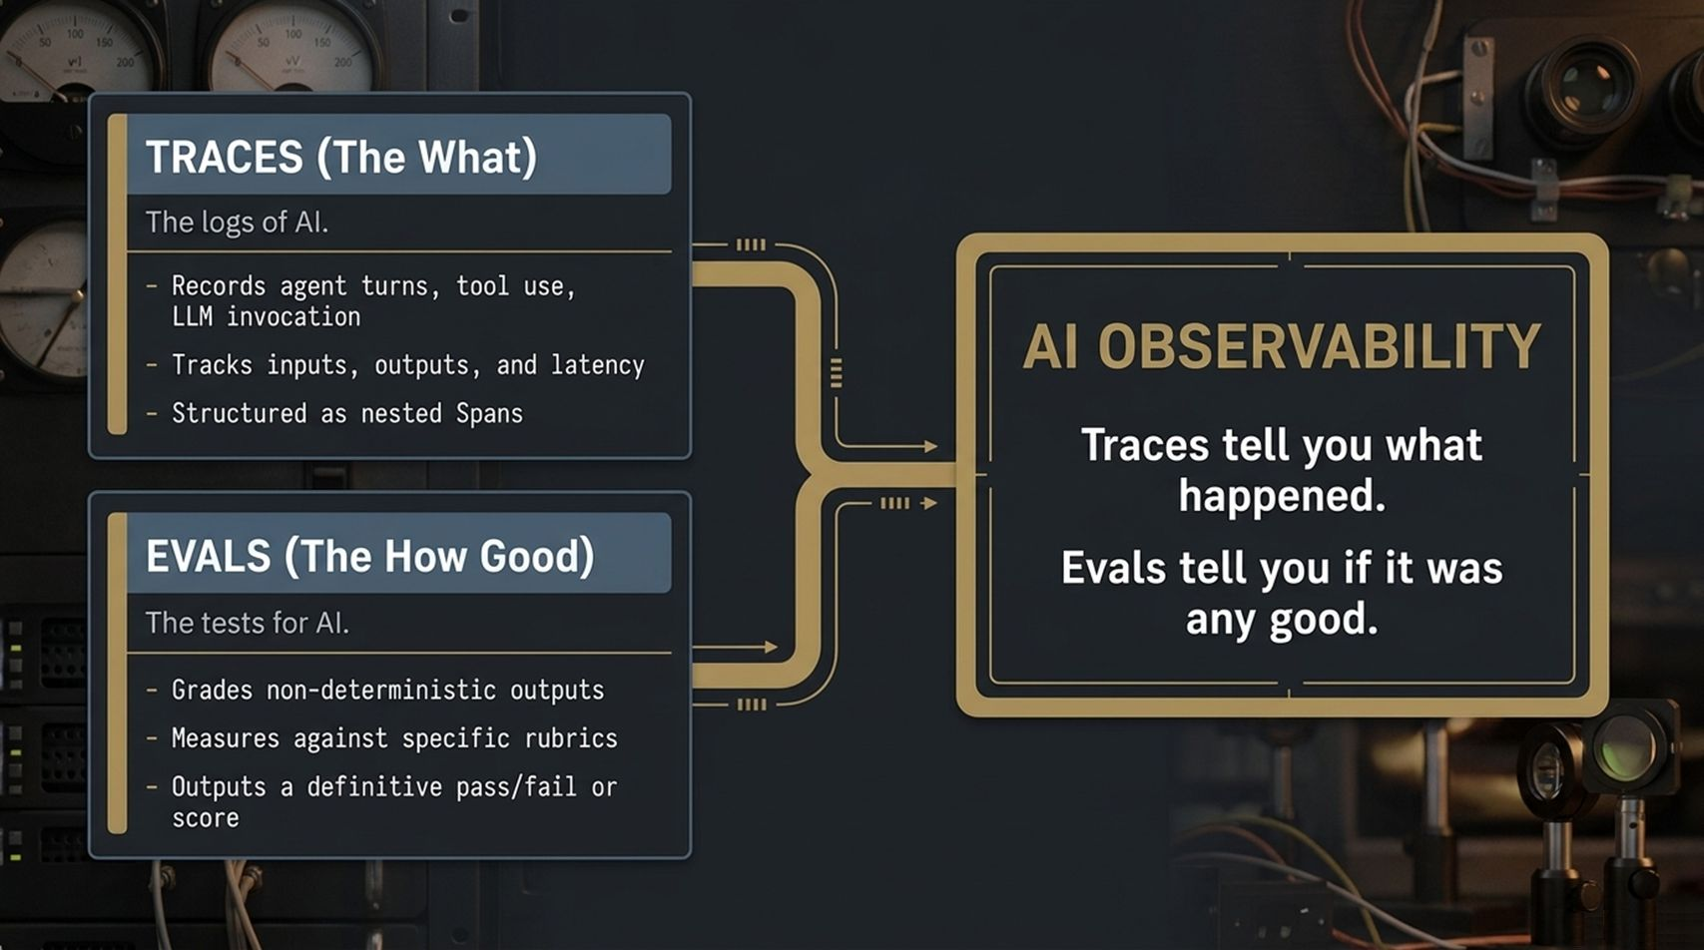
Notes:
Before we build an evaluation suite, we must establish the two fundamental pillars of AI Observability: Traces and Evals. People often use these terms interchangeably, but they serve two completely different operational functions.
1. TRACES (The 'What'): Traces are the execution logs of AI. When a user sends a query to an agent, a trace records every single turn, tool execution, API call, and LLM invocation from start to finish. Traces capture raw inputs, outputs, token counts, and latency, structured as a hierarchy of nested spans. Traces give you complete visibility into the execution graph.
2. EVALS (The 'How Good'): If Traces are the logs, Evals are the software unit tests and integration tests for AI. Evals take those non-deterministic outputs recorded in the traces and grade them against specific, objective rubrics. An eval processes an execution span and outputs a definitive pass/fail or a numeric score.
Summarized simply by the core rule on the right: Traces tell you what happened. Evals tell you if it was any good. You cannot run effective evals without high-fidelity traces, and traces are useless bloat without evals to extract signal from the noise.

Slide 4
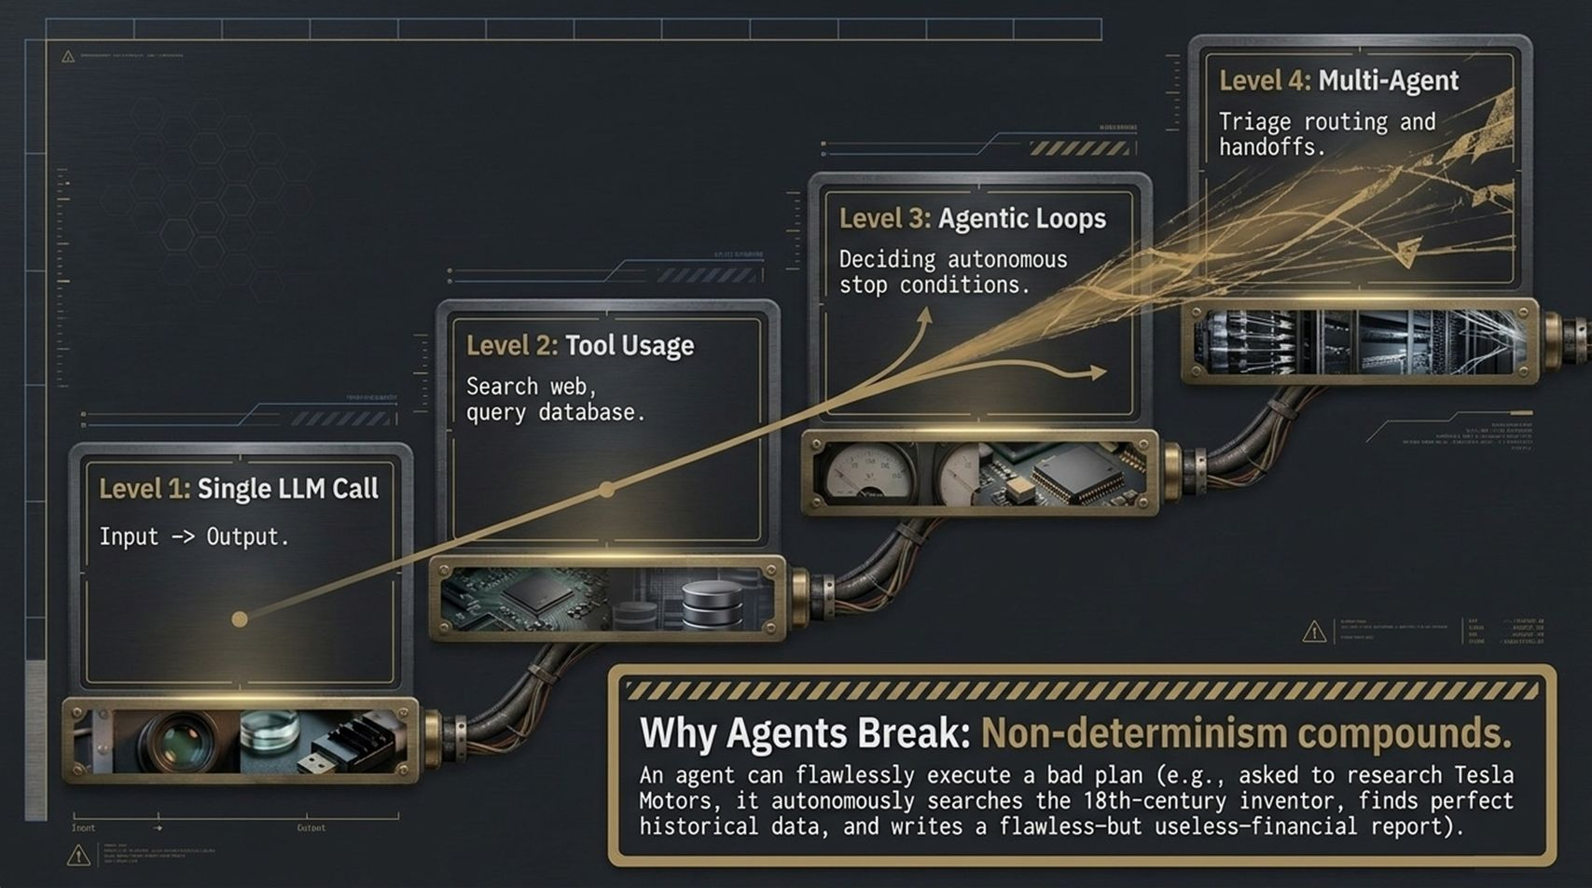
Notes:
Why is evaluating AI agents so much harder than evaluating traditional software or even single LLM calls? The answer lies in compounding non-determinism.
Look at the progression stair-step on this slide:
Level 1 (Single LLM Call): Input goes in, output comes out. Simple prompt-response mechanics.
Level 2 (Tool Usage): The LLM dynamically decides to call external APIs—searching the web or querying a SQL database.
Level 3 (Agentic Loops): The agent autonomously plans, executes actions, observes environment feedback, and decides its own stop conditions.
Level 4 (Multi-Agent Systems): Triage routing, handoffs, and delegation between specialized sub-agents.
As you move up these levels, non-determinism doesn't scale linearly—it compounds exponentially.
Consider the real-world failure example highlighted at the bottom: Imagine asking an investment agent to analyze 'Tesla Motors.' The agent generates a search query, but due to slight non-determinism, it autonomously searches for Nikola Tesla, the 18th-century inventor. It retrieves flawless historical data, performs immaculate analysis, and writes a perfectly formatted, 10-page financial report.
The agent flawlessly executed a completely bad plan. If you only evaluate the final text formatting, it passes. But the output is utterly useless. That is why traditional testing fails for agents.

Slide 5
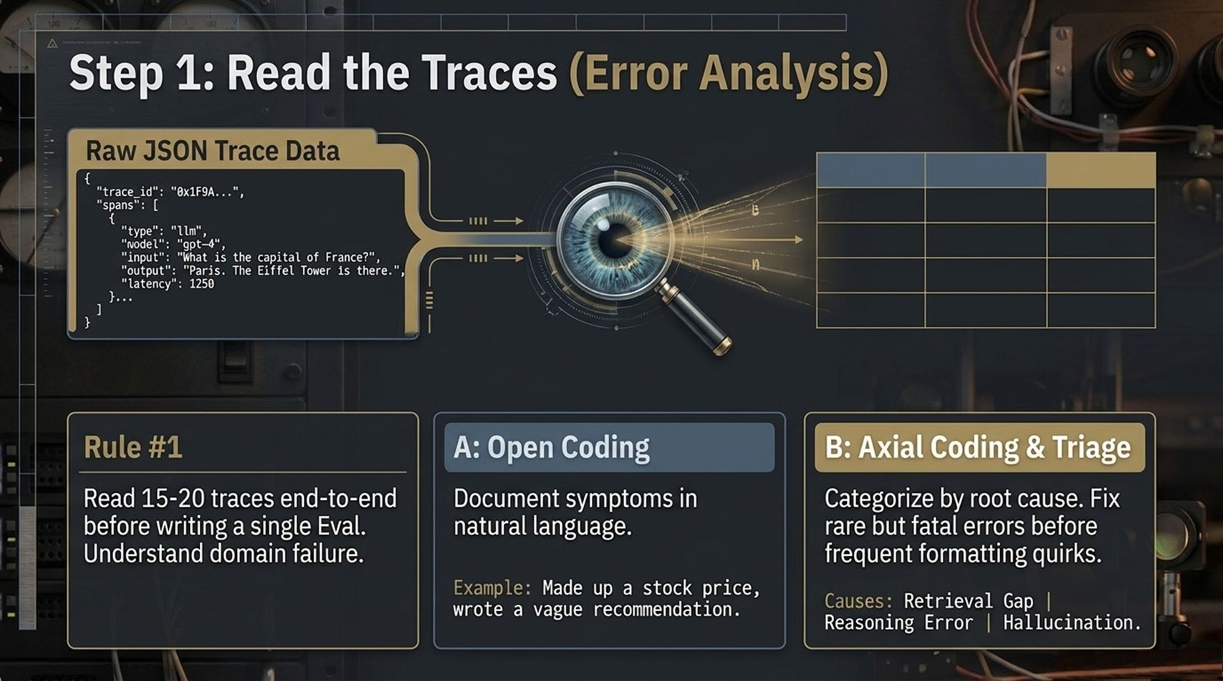
Notes:
When engineering teams decide to build evals, their first instinct is to immediately start writing code or prompting LLM judges. That is a mistake.
Rule #1 of AI Evaluation: Read 15 to 20 raw traces end-to-end before writing a single evaluation metric. You must intimately understand your domain failure modes first.
To do this rigorously, we adopt a classic qualitative methodology split into two steps:
Step A: Open Coding
Open your observability dashboard and inspect raw JSON traces. Document every weird symptom in plain, descriptive natural language. For example: 'Agent made up a stock price,' or 'Agent gave a super vague, non-actionable recommendation.'
Step B: Axial Coding & Triage
Group those natural language symptoms into root-cause taxonomy buckets. Are failures happening because of a Retrieval Gap (the context didn't contain the data), a Reasoning Error (the context was there, but the LLM miscalculated), or a Hallucination?
Triage Rule: Prioritize fixing rare but fatal errors (like financial inaccuracies) long before worrying about frequent formatting quirks. Understand the root cause first, then write the eval.

Slide 6
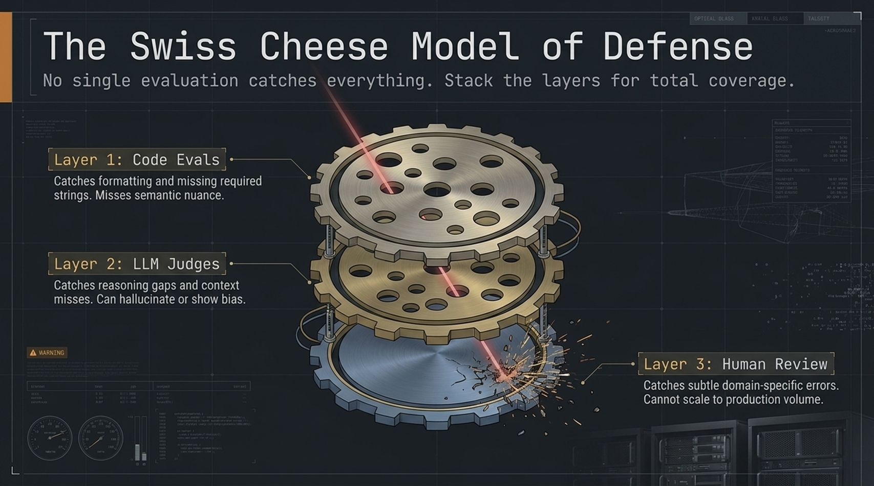
Notes:
Once you understand your failure modes, how do you catch them? You implement The Swiss Cheese Model of Defense.
In safety engineering, the Swiss Cheese Model posits that no single defense layer is perfect; every layer has holes. But if you stack multiple diverse layers together, the holes don't align, and malicious bugs cannot slice all the way through.
We stack three specific evaluation layers:
Layer 1: Code Evals (Deterministic): Fast, free, zero-latency programmatic checks. They catch missing JSON keys, length bounds, or missing required ticker symbols. The hole in Layer 1: It has zero understanding of semantic meaning.
Layer 2: LLM Judges (Probabilistic): Model-based evaluators using structured rubrics. They catch complex reasoning gaps, tone mismatches, and ungrounded statements. The hole in Layer 2: LLMs can occasionally hallucinate or exhibit model bias.
Layer 3: Human Review (Subjective): Domain experts auditing sampled outputs. They catch deeply subtle, domain-specific logic errors. The hole in Layer 3: Humans are slow, expensive, and cannot scale to production volumes.
Stacking deterministic code, probabilistic LLM judges, and targeted human spot-checks gives you bulletproof evaluation coverage.

Slide 7
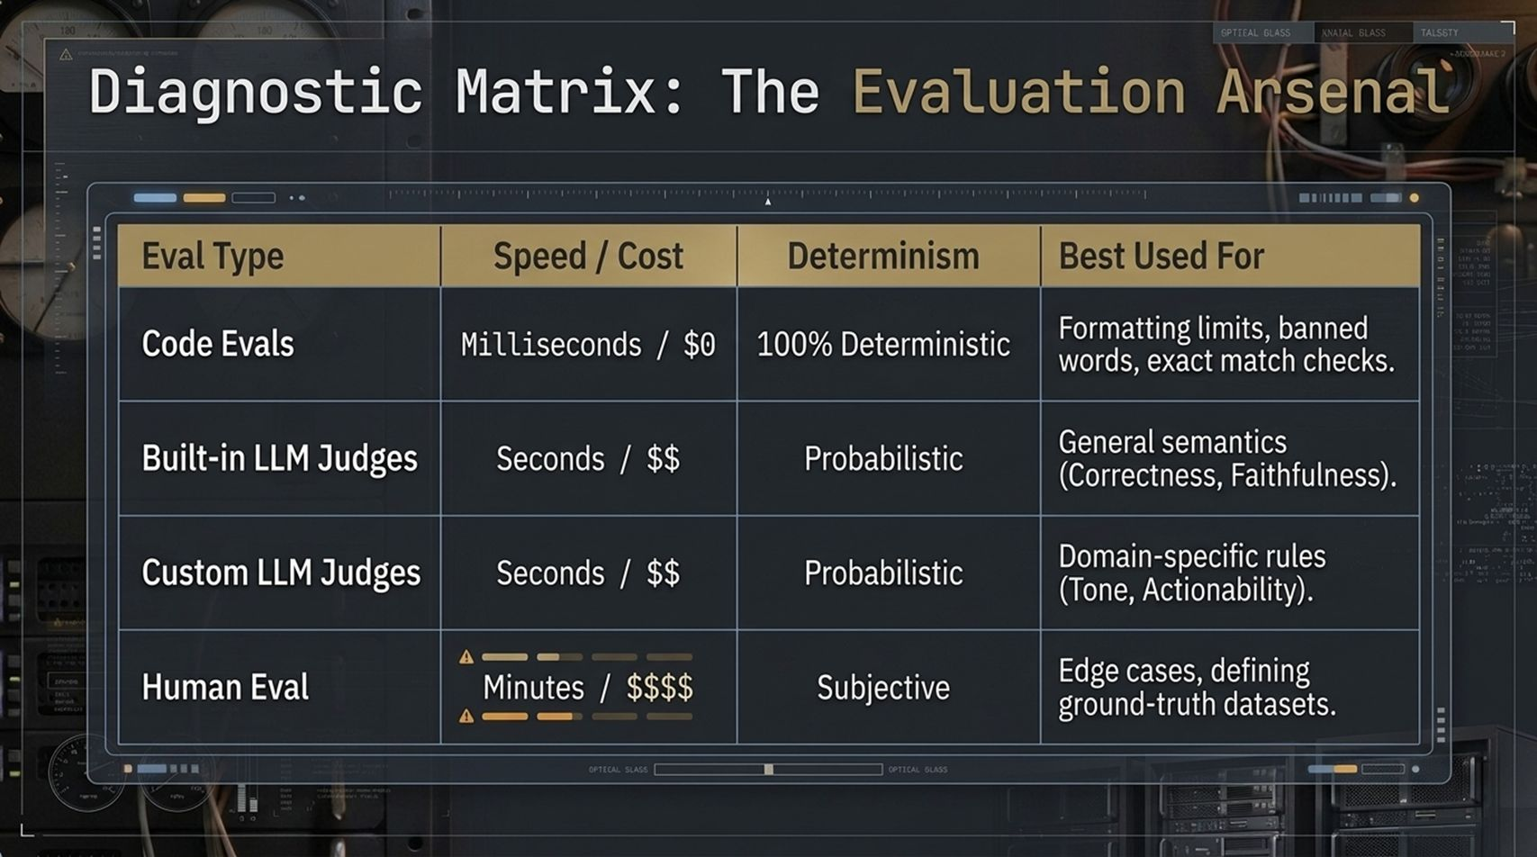
Notes:
To choose the right eval layer for the right task, use this Diagnostic Matrix to evaluate trade-offs across speed, cost, determinism, and best use cases:
Code Evals: Execution time is in milliseconds, cost is $0, and determinism is 100\%[cite: 18]. Use them for strict formatting limits, banned phrase detection, and exact match schema validation[cite: 18]. > 2. **Built-in LLM Judges:** Execution time is seconds, cost is low ($), and results are probabilistic. Use them for standard semantic metrics like generalized correctness, context recall, and faithfulness. > 3. Custom LLM Judges: Execution time is seconds, cost is low ($), and results are probabilistic. Use them when your business has unique domain rules—like auditing brand voice, regulatory compliance, or financial actionability. > 4. Human Eval: Execution time takes minutes/hours, cost is extremely high ($$$$), and results are subjective. Reserve human review exclusively for edge-case tie-breaking and establishing gold-standard ground-truth datasets.
Architecture decisions are about allocation: run Code Evals on 100% of traffic, LLM Judges on target sample sets, and Human Evals on curated golden datasets.

Slide 8
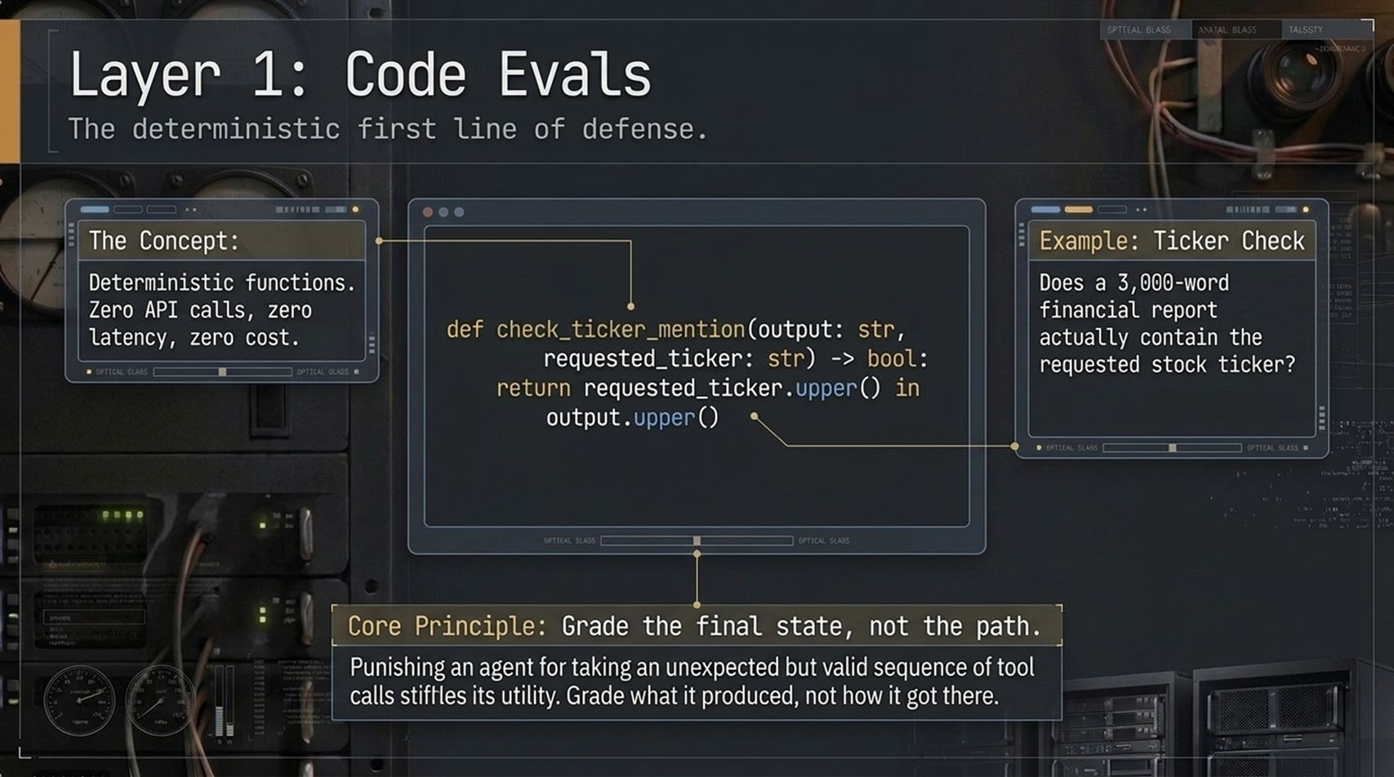
Notes:
Let's dive deeper into Layer 1: Code Evals.
The concept here is pure software engineering: write deterministic functions that require zero API calls, incur zero token costs, and execute with zero latency.
Look at the Python snippet on the slide: check_ticker_mention(output, requested_ticker). If a user asks for a financial breakdown of Apple (AAPL), a simple string check verifies whether 'AAPL' appears in the final 3,000-word output. If it doesn't, the test fails instantly before you ever waste a penny calling a expensive LLM judge.
The Core Principle of Agentic Code Evals: Grade the final state, not the path.
This is a massive mental shift for developers. In traditional unit testing, you mock and assert every exact function call sequence. But if you punish an autonomous agent for taking an unexpected sequence of tool calls—even if that sequence successfully solved the problem—you completely destroy its autonomous utility.
Assert on the final output artifact and system state, not the specific path the agent took to get there.

Slide 9
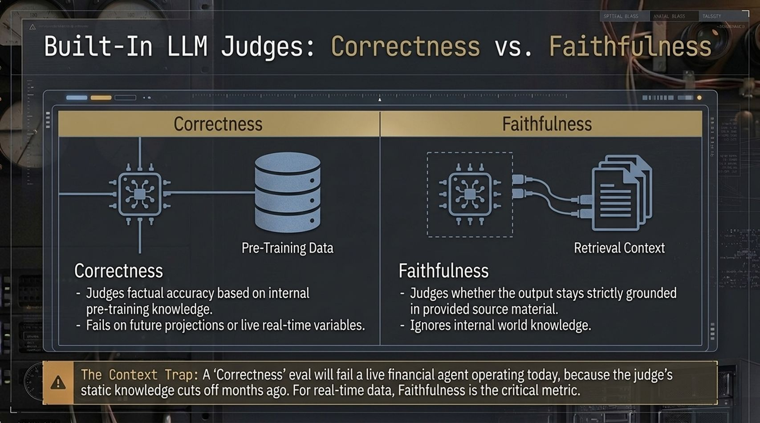
Notes:
When moving to Layer 2 (LLM Judges), the single most critical distinction you must make is between Correctness and Faithfulness. Confusing these two will ruin your evaluation telemetry.
Correctness (Pre-Training Knowledge): Correctness evaluates factual accuracy against the judge's internal pre-training data. For static historical facts (e.g., 'What is the capital of France?'), Correctness works fine.
Faithfulness (Retrieval Context Grounding): Faithfulness evaluates whether the agent's output is strictly grounded in the provided retrieval context, completely ignoring the model's internal world knowledge.
Beware 'The Context Trap': Look at the warning callout on the slide. Suppose you have a live financial agent generating stock summaries today. If you run a 'Correctness' eval, an LLM judge whose knowledge cutoff was months ago will mark today's accurate stock price as incorrect because it doesn't match its stale pre-training memory!
For dynamic, live-data, or RAG-based agentic applications, Faithfulness is your critical metric, not static Correctness.

Slide 10
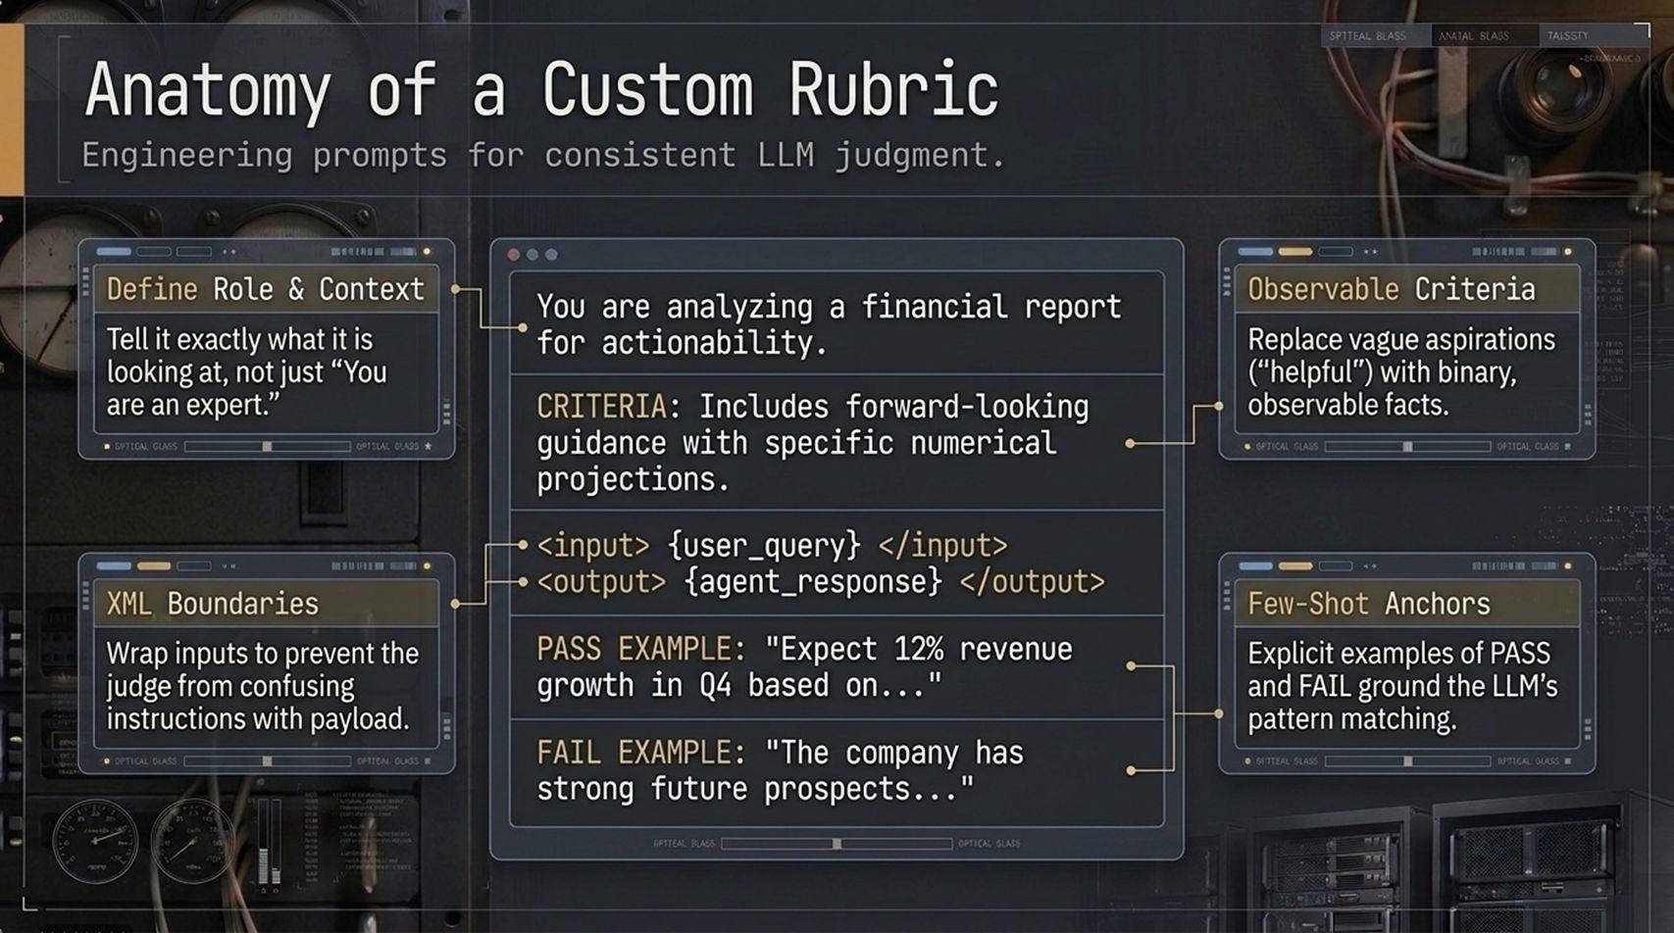
Notes:
When built-in evals aren't enough, you must engineer Custom LLM Rubrics. How do you write a prompt that forces an LLM judge to act like a consistent, unbiased grader? You follow these four architectural pillars:
Define Role & Context: Don't just say 'You are an expert.' Tell it explicitly what it is analyzing and why: 'You are analyzing a financial report for actionability.'
Observable Criteria: Eliminate vague, subjective aspirations like 'Make sure the output is helpful.' Replace them with binary, observable facts: 'CRITERIA: Includes forward-looking guidance with specific numerical projections.'
XML Boundaries: Wrap inputs in strict XML tags like <input> and <output>. This prevents prompt injection and stops the judge from confusing instructions with payload content.
Few-Shot Anchors: Provide explicit examples of a PASS and a FAIL. Concrete examples anchor the LLM judge's pattern matching and eliminate variance.

Slide 11
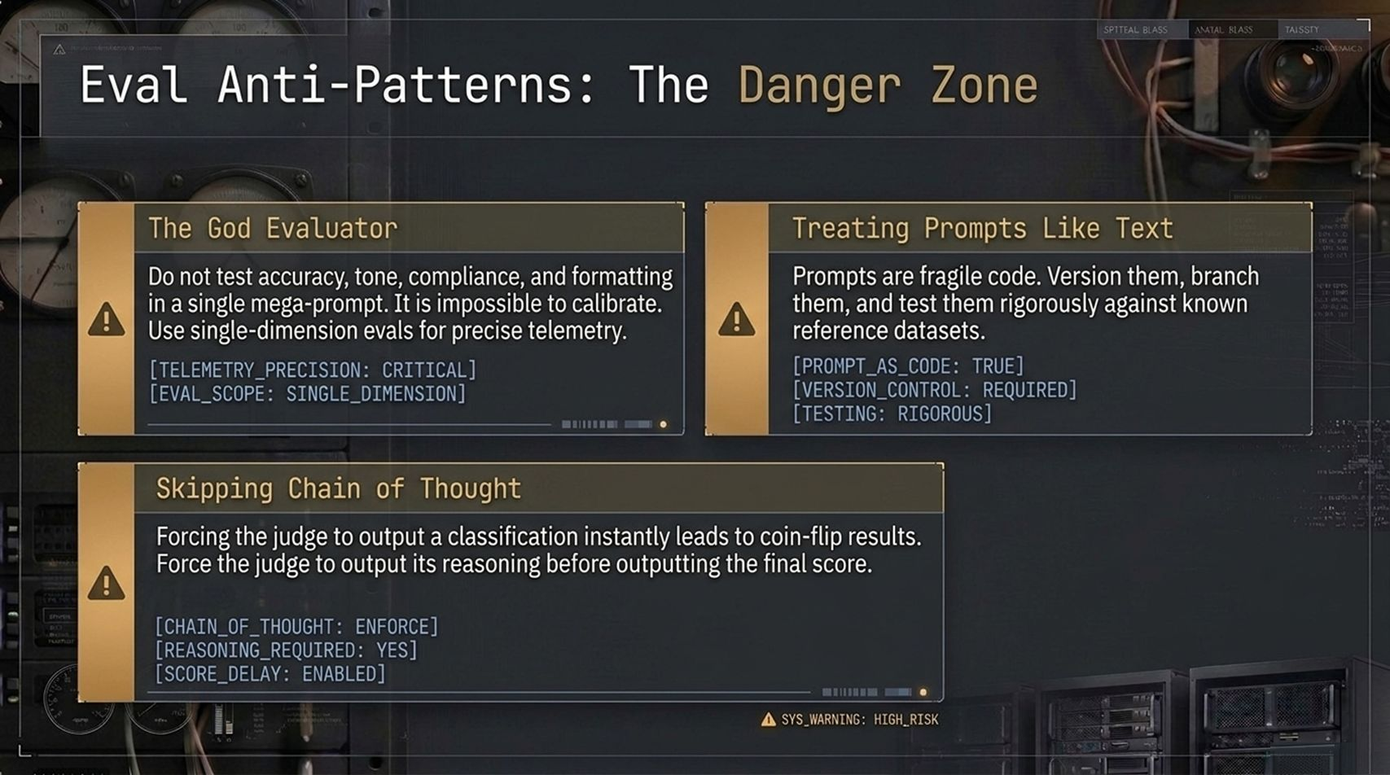
Notes:
As you build out your evaluation engine, watch out for three dangerous anti-patterns that frequently destroy eval reliability:
1. The God Evaluator: Never attempt to test factual accuracy, brand tone, regulatory compliance, and markdown formatting all inside a single mega-prompt. When a mega-prompt fails, you have zero telemetry into why it failed. Write single-dimension evaluators to keep your telemetry precise.
2. Treating Prompts Like Text: Prompts are not documentation; prompts are executable code. You must version control them, branch them, and test prompt updates against known reference datasets in CI before pushing to production.
3. Skipping Chain of Thought: Forcing an LLM judge to output an instant 'PASS/FAIL' token leads to coin-flip results. Always force the judge to generate its step-by-step reasoning before emitting the final score. Generating reasoning tokens unlocks the model's computation power and drastically improves scoring accuracy.

Slide 12
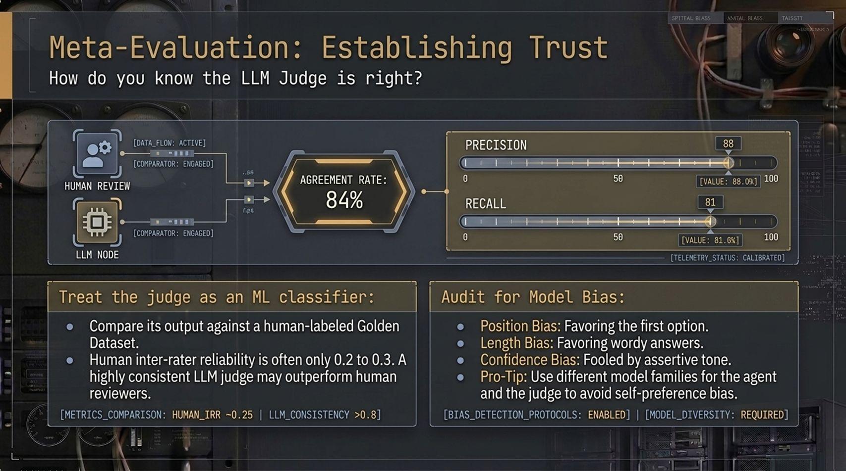
Notes:
Here is the classic question every engineering VP asks: 'If an LLM is judging our LLM agent, who evaluates the judge?'
The answer is Meta-Evaluation—the process of evaluating your evaluators.
1. Treat the Judge as an ML Classifier: Run your LLM judge against a human-labeled 'Golden Dataset.' Calculate the agreement rate, precision, and recall. On this slide, you see an 84% agreement rate between human annotations and the LLM judge. Interestingly, human inter-rater reliability is often quite low (0.2 to 0.3). A well-calibrated, deterministic LLM judge will often be more consistent than a team of sleepy human reviewers.
2. Audit for Model Biases: Watch out for three notorious LLM judge biases:
Position Bias: Favoring the first option presented.
Length Bias: Favoring wordy, verbose answers over concise ones.
Confidence Bias: Being fooled by an assertive, confident tone even when facts are wrong.
Pro-Tip: Always use a different model family for your judge than your agent (e.g., if Claude powers your agent, use GPT-4o as your judge) to prevent self-preference bias.

Slide 13
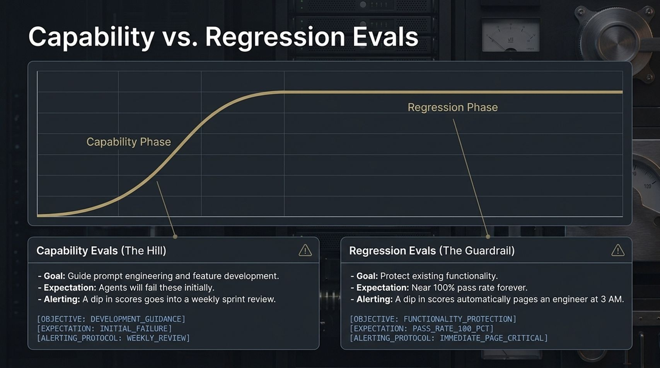
Notes:
Not all evals serve the same stage of the software development lifecycle. You must segregate Capability Evals from Regression Evals.
Look at the curve on the slide:
Capability Evals (The Hill): These evals are designed to guide active R&D and feature development. When you write a capability eval for a complex new multi-step feature, you expect the agent to fail initially. The goal is to measure progress as you tune prompts and add tools. Alerting policy: Dips in capability scores belong in a weekly sprint review.
Regression Evals (The Guardrail): Once a feature is shipped, you lock down its test cases into a regression suite. The expectation here is a near-100% pass rate forever. Alerting policy: A dip in regression scores automatically blocks the deployment build and pages an engineer at 3 AM.
Never mix capability tests into your blocking CI pipeline, or your deployments will grind to a halt.

Slide 14
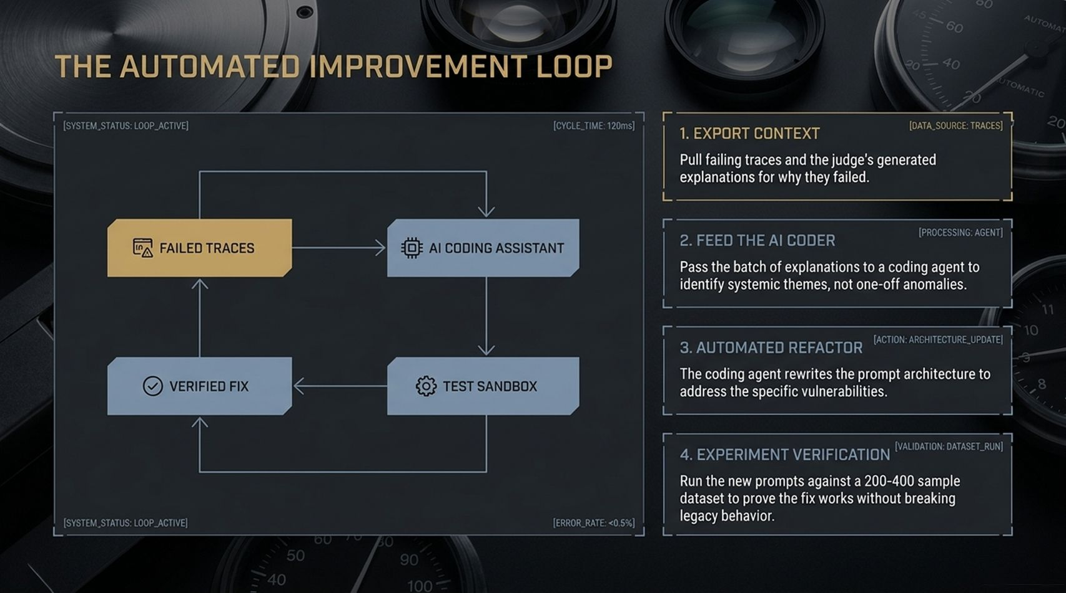
Notes:
Now we arrive at the cutting edge of AI engineering: The Automated Improvement Loop.
Once your evaluation stack is running, you can connect your evaluation telemetry directly back into an AI coding assistant to create a self-healing prompt architecture.
Here is how the 4-step loop works:
Export Context: Automatically pull failing traces from production, along with the LLM judge's generated explanations for why they failed.
Feed the AI Coder: Pass batches of these failure explanations into a coding agent to identify systemic thematic weaknesses rather than isolated noise.
Automated Refactor: The coding agent rewrites the system prompt architecture or tool descriptions to address specific failure vulnerabilities.
Experiment Verification: Before merging, the system automatically executes the candidate prompt against a 200–400 sample regression dataset in a test sandbox to prove the fix works without breaking legacy behavior.
Human engineers shift from manually tweaking prompts to supervising the automated refactoring pipeline.

Slide 15
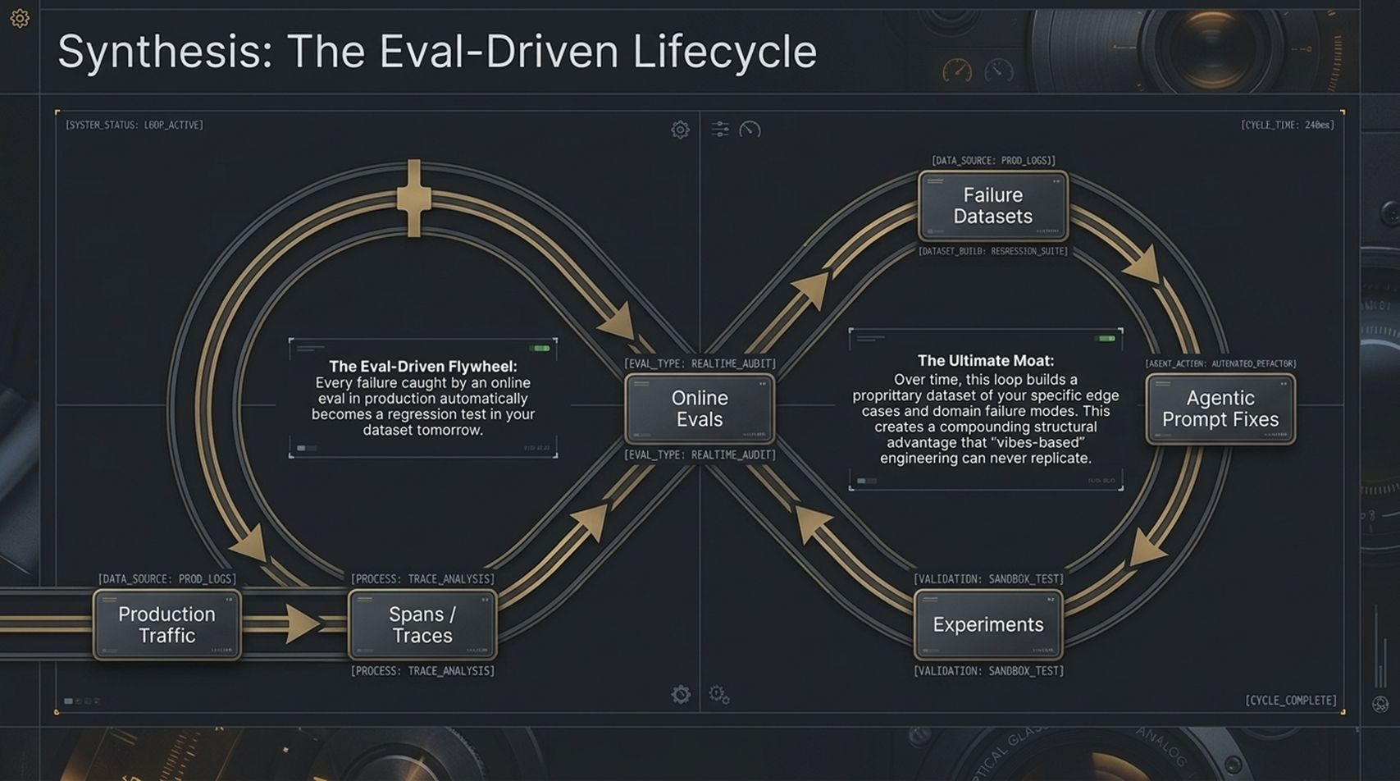
Notes:
Let's synthesize everything into the Eval-Driven Lifecycle. This double-loop infinity diagram represents the complete production lifecycle of modern AI software.
The Left Loop (Production Operations): Production traffic streams into your application, generating spans and traces. Online Evals continuously audit a percentage of live traffic in real time. Every single failure caught by an online eval automatically feeds directly into the right loop.
The Right Loop (Automated Engineering): Production failures populate your failure datasets. Agentic prompt refactorers generate candidate fixes, test them in isolated sandboxes through offline experiments, and merge verified updates back into production.
The Ultimate Competitive Moat: Over time, this continuous double loop builds a massive, proprietary dataset of your specific edge cases and domain failure modes. Models will become commoditized, but a proprietary evaluation suite is a compounding structural advantage that 'vibes-based' engineering can never replicate.

Slide 16
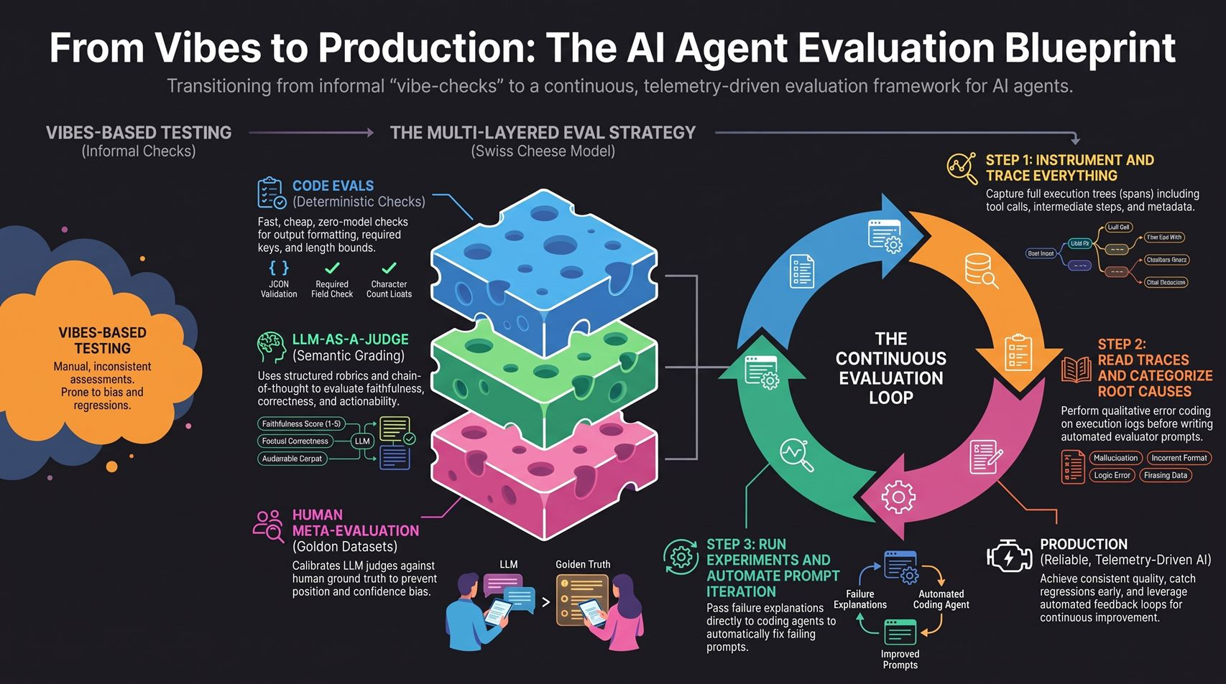
Notes:
To close out today's playbook, let's review the complete AI Agent Evaluation Blueprint summarized on this final slide:
1. Transition Away from Vibes: Replace manual, inconsistent vibe-checks with telemetry-driven evaluation architectures.
2. Deploy the Swiss Cheese Strategy: Layer deterministic Code Evals (fast, zero cost) for formatting, LLM-as-a-Judge (semantic rubrics with chain-of-thought) for reasoning and faithfulness, and Human Meta-Evals for calibrating golden datasets.
3. Execute the Continuous Evaluation Loop:
Step 1: Instrument and trace everything—capture full execution trees, tool calls, and intermediate states.
Step 2: Read traces and categorize root causes into clear error taxonomies.
Step 3: Run automated experiments, passing failure explanations to coding agents to continuously improve system prompts.
Following this blueprint allows you to ship AI agents with the confidence of traditional software engineering—achieving consistent quality, catching regressions before users do, and shipping robust AI systems into production.
Thank you! Let's open the floor to questions.
From Vibes to Production: Evaluating and Shipping AI Agents That Work 101 — Laurie Voss, Arize AI
https://www.youtube.com/watch?v=qZj7sqmidqA

